Slide 1
Essay/Writing Tips
Make notes!
English 11

Slide 2
“I”
Avoid referring to yourself (or to the reader – “you”) in your papers.
It is not necessary to say “I think Lady Macbeth is going insane”, just say “Lady Macbeth is going insane”. It’s your essay, so we already know it’s what you think.
Avoiding this makes your writing seem much stronger because it shows confidence in your arguments.

Slide 3
Titles
Short story titles go in quotation marks.
“The Possibility of Evil” deals with the idea that evil may be lurking in unlikely places.
Play titles are underlined or italicized.
Macbeth contains many supernatural elements.
Macbeth contains many supernatural elements.
Novel titles (and other complete works) are underlined or italicized.
Jack acts like a bully in Lord of the Flies.
Jack acts like a bully in Lord of the Flies.
Poem titles go in quotation marks.
Langston Hughes wrote “Mother to Son”.

Slide 4
Pick a side!
If you’re writing a persuasive piece, make sure that you choose a side and argue it. Do not stay “on the fence” and try to argue both sides. It will make your argument seem weak if you can’t even choose a side.
Make your argument/thesis/topic clear as soon as possible, and spend the rest of your paper focusing only on that – do not stray from it or get caught up in summary.
With this is mind, it is still good to acknowledge the “other argument” to show that you’ve considered both sides
“While Charlotte’s mother may have raised Charlotte, Miss Hancock still has a greater impact on Charlotte.

Slide 5
FANBOYS
Remember these? FANBOYS is the acronym used to remember the 7 coordinating conjunctions used to join sentences into compound sentences: for, and, nor, but, or, yet, so.
eg. I went to the store, and my brother went to school.
He bought a pair of jeans, but his mother did not like them.
They did not want to go to school, so they stayed home instead.
Try to avoid starting a sentence with a FANBOYS. 9 times out of 10 they are not necessary and can be left out.

Slide 6
: versus ;
Many people seem to be confused about how colons and semicolons are used.
Colons (:) may be used after a complete sentence to introduce a list or provide explanation.
There are three types of people in the world: those who can count and those who can’t.

Slide 7
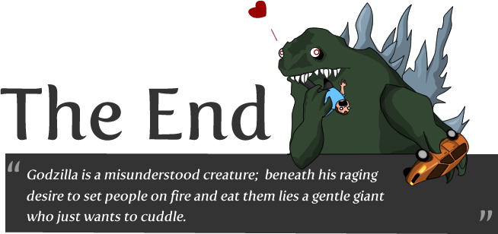
: versus ;
Think of a semicolon (;) as a super comma. Unlike a comma, a semicolon can be used to connect two complete sentences. The sentences should be related.

Slide 8
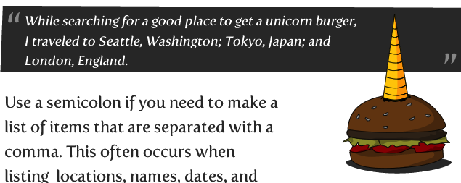
: versus ;
Use a semicolon to separate items in a list that also contain commas (this makes the list less confusing):
We went to Tokyo, Japan; London, England: and Paris, France.

Slide 9
[ ]
Square brackets are used when you need to slightly modify quotations.
“Charlotte claimed that ‘[she] killed Miss Hancock’” (215).
Note that the line reference is in regular parentheses ( ).

Slide 10
Referencing acts/scenes/lines
When you quote more than one line from the play, use a slash / to indicate the line breaks.
For line referencing, you must indicate the act (capital roman numerals), scene (lowercase roman numerals), and line numbers (regular numbers) separated by periods.
Banquo says he “must become a borrower of the night” (III.i.27).
Roman numerals from 1 – 10 are:
I, II, III, IV, V, VI, VII, VIII, IX, X
i, ii, iii, iv, v, vi, vii, viii, ix, x

