Slide 1
The Ways of Knowing
Sense Perception LANGUAGE Reason EMOTION Memory IMAGINATION Intuition IN RELATION TO Sense Perception LANGUAGE Reason EMOTION Memory IMAGINATION Intuition IN RELATION TO Sense Perception LANGUAGE Reason EMOTION Memory IMAGINATION Intuition IN RELATION TO Sense Perception LANGUAGE Reason EMOTION Memory IMAGINATION Intuition IN RELATION TO Sense Perception LANGUAGE Reason EMOTION Memory IMAGINATION Intuition IN RELATION TO Sense Perception LANGUAGE Reason EMOTION Memory IMAGINATION Intuition IN RELATION TO Sense Perception LANGUAGE Reas
Ways of Knowing
Notes:
We humans come to know and understand the world around us using many methods for acquiring knowledge and evaluating information.
We call these the ways of knowing

Slide 2
How do we know what we know?
We gain knowledge in many ways:
Language
Sense perception (sight, touch, smell, hearing, taste).
Emotion
Reason
Imagination
Intuition
Memory
In relation to (relative to)

Slide 3
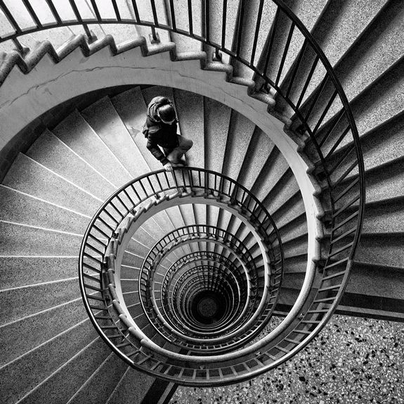
We use Ways of Knowing in combination together.
Sometimes we use 1 Way of Knowing to acquire knowledge.
Each of the Ways of Knowing has limitations we must be aware of…

Slide 4
Memory as a way of knowing
“Without memory, there is no culture. Without memory, there would be no civilization, no society, no future.” - Elie Wiesel

Slide 5
Memory
We need memory to keep knowledge
We remember how to do things
Memory refers to things which we believe really happened.
New knowledge is dependent on and influenced by memory.
For example, how we interpret new situations can be heavily influenced by experience and previous events.
Memory retrieval is often regarded as unreliable, for example, because it is seen to be subjective or heavily influenced by emotion.
We rely on our memory every day and because many of our memories seem to be reliable, this gives us confidence that our other memories are reliable.

Slide 6
researchers understand that that the process of recalling a memory actually changes it. “Each time you retrieve a memory it undergoes this storage process,” Schiller told me over the phone the day before EmTech. That means the memory is in an unstable state, rewritten and remodeled every time it is retrieved.
“We don’t really remember the original; we remember the revised version,” she said.

Slide 7
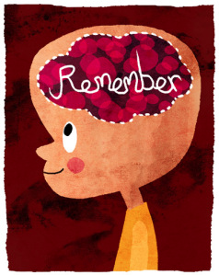
“You can influence eyewitness testimony just by investigating an event,”
“The only way to keep memories as they are … is to carve them into a story or art form that captures the original emotion.”
-Neuroscientists Daniela Schiller

